Slide 1

Classifying Heart Disease Using Machine learning
Guided by : Mr P Vinod babu
Project done by:
CH Shiva (1215316314) P Akhil (1215316316)
M Chakradhar (1215316339)
T Atreya Pavan (1215316357)

Slide 2
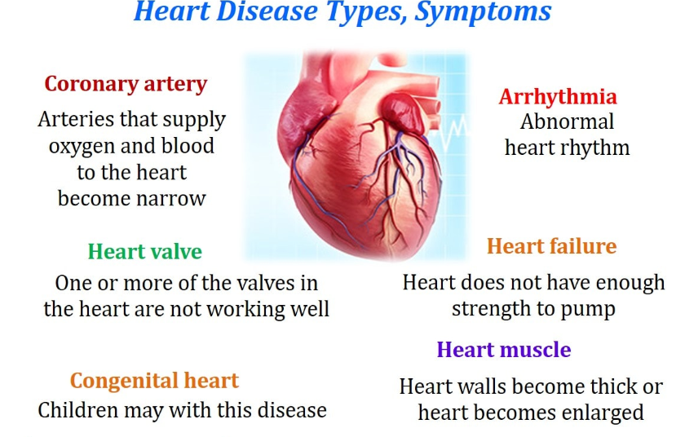
Introduction
Heart disease is obstruction to the coronary arteries with symptoms such as angina , chest pain and heart attacks. In India there are roughly 3 crores heart patients and 2 lakh open heart surgeries are performed every year . The reason for this is smoking ,high level of cholesterol , diabetes .Early prediction of heart diseases is essential to reduce the morality rate . Data mining provides a user oriented approach to extract novel and uncovered patterns in the data set.

Slide 3
Problem statement
Heart diseases are the main cause of death globally that is more people die annually from heart diseases than from any other cause. An estimated 17.9 million people died from heart attacks in 2016, representing 31% of all global deaths of these 85% are died due to heart attacks – WHO. Most Heart diseases can be prevented by taking some risk factors into consideration like age, diet, obesity, physical inactivity, etc. These all patients details are stored by the hospitals in their respective hospital’s databases or physically in paper format but they are not using it for any purpose.

Slide 4
Abstract
Machine Learning is used around the world in various organizations in various fields. The healthcare industry cannot be negligible. Machine Learning and Artificial Intelligence are playing a very crucial role in predicting existence or absence of disorders, lung diseases and more. We are predicting heart diseases well in advance using information that is data given by hospital used to provide a great value of information to the doctors so they can prescribe the patient with better treatment. The algorithms used to predict heart diseases are Decision Tree Classifier, K Neighbours Classifier, Random Forest Classifier, Principal Component Analysis and Support Vector Classifier. We applied many operations on data in order to make data efficient and consistent without outliers, missing values, etc so that while applying algorithms they can perform more efficiently. We used Train Test Split and also K-Fold Cross Validation to train and test the efficiency of algorithm when the data is applied. The accuracy of each algorithm is given in the comparison table.

Slide 5
Existing System
Heart disease is even being highlighted as a silent killer which leads to death of a person without obvious symptoms. This nature of this disease is the cause of growing anxiety about the disease and its consequences . Hence continued efforts are being done to predict the possibility of this deadly disease in prior.
As the well known quote says “Prevention is better than cure”, early prediction and its control can be helpful to prevent and decrease the death risks due to heart disease.
All patients' details are stored by the hospitals in their respective hospital’s databases or physically in paper format but they are not using it for any purpose.
Drawback:
Difficult to analyse for the doctor to predict whether a patient has heart disease or not
When the early symptoms of heart disease are ignored , the patient might end up with drastic consequences in a short span of time

Slide 6
Proposed System
Heart disease is the leading cause of death among all other disease . Due to lack of resources in the medical field the prediction of heart disease occasionally may be problem .This issue can be resolved by adopting Machine learning techniques
The working of the system architecture is described step by step:
1. Dataset contains all the heart patients’ details.
2. In attribute selection process we select the required attributes used to analyse the data which are important and we drop unnecessary attributes which are not required.
3. Then we pre-process data such as filling missing values, etc.
4. Then we applied some data science algorithms to analyse and predict the condition of the heart patient which is vulnerable or not.
5. Finally, we measured accuracy of each algorithm we applied to the data.

Slide 7
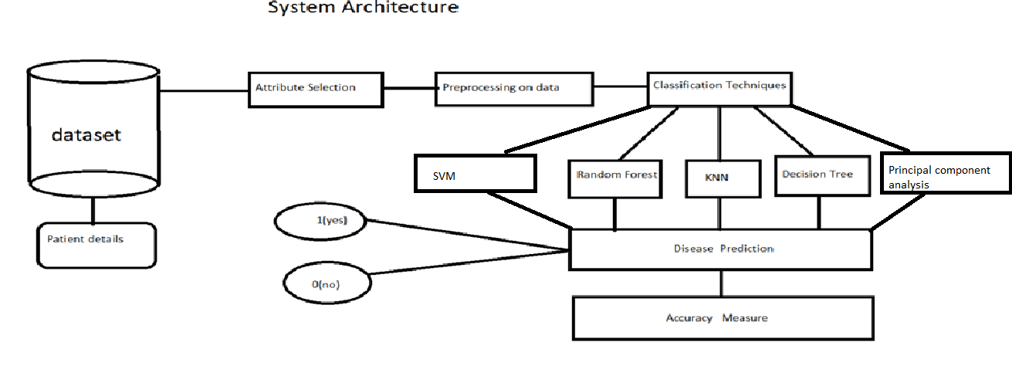
PROPOSED SYSTEM ARCHITECTURE

Slide 8
K-CROSS VALIDATION
The general procedure is as follows:
Shuffle the dataset randomly
Split the dataset into k groups
For each unique group:
Take the group as a hold out or test data set
Take the remaining groups as a training data set
Fit a model on the training set and evaluate it on the test set
Retain the evaluation score and discard the model
Summarize the skill of the model using the sample of model evaluation scores

Slide 9
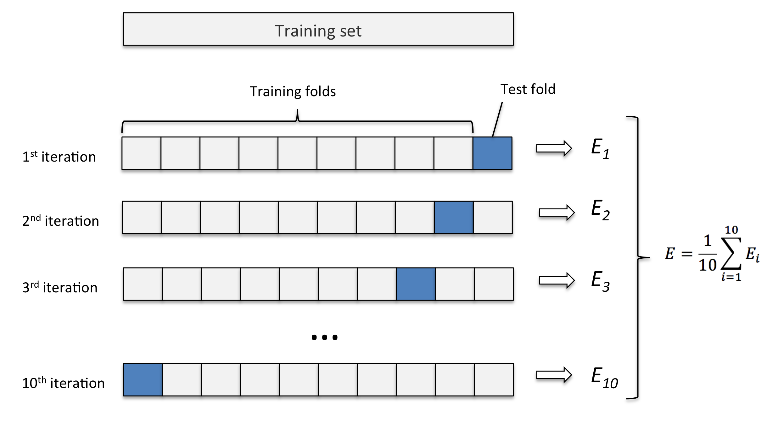
10 - FOLD CROSS VALIDATION

Slide 10
Import libraries
Numpy : To work with arrays
Pandas : To work with csv files and data frames
Matplotlib: To create charts using pyplot , define parameter and color them.
Seaborn : Also used for visualization

Slide 11
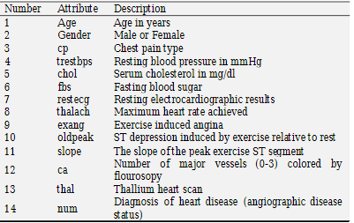
Import dataset
After downloading the dataset from Kaggle ,I saves it to my working directory with the name dataset.csv . Next, we used reas_csv() to read the dataset and save it to the the dataset variable.
Before any analysis, we have taken a look at the data. So , we used the info() method.
As you can see from the output, there are a total of 13 features and 1 target variable.

Slide 12
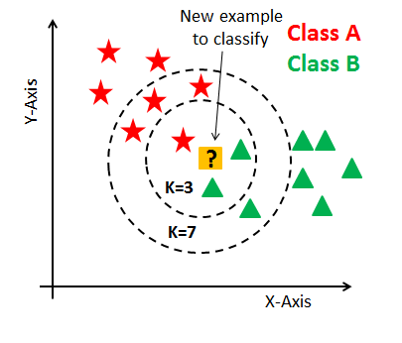
K-nearest neighbour(KNN)
The K nearest neighbour working principle is based on assignment of weight to the each data point which is called as neighbour . We can measure the distance between the data points using Euclidian , Manhattan and Minkowski distances in KNN.
Steps to compute K-NN algorithm:
1)Determine parameter K=Number of clusters
2)Calculate the distance between the query-Instance and all the training samples
3)Sort the distance and determine nearest neighbours based on the K-th minimum distance
4)Gather the category of the nearest neighbours
5)Use a simple majority of the category of nearest neighbours
as the prediction value of the query

Slide 13
Result
As you can see, we achieved the maximum score of 93% when the number of neighbors was chosen to be 3.

Slide 14
Decision tree
A decision tree is a flowchart-like structure in which each internal node represents a “test” on an attribute (e.g. whether a coin flip comes up heads or tails), each branch represents the outcome of the test, and each leaf node represents a class label (decision taken after computing all attributes). The paths from root to leaf represent classification rules.
Tree based learning algorithms are considered to be one of the best and mostly used supervised learning methods. Tree based methods empower predictive models with higaccuracy, stability and ease of interpretation. Unlike linear models, they map non-linear relationships quite well. They are adaptable at solving any kind of problem at hand (classification or regression). Decision Tree algorithms are referred to as CART (Classification and Regression Trees).

Slide 15
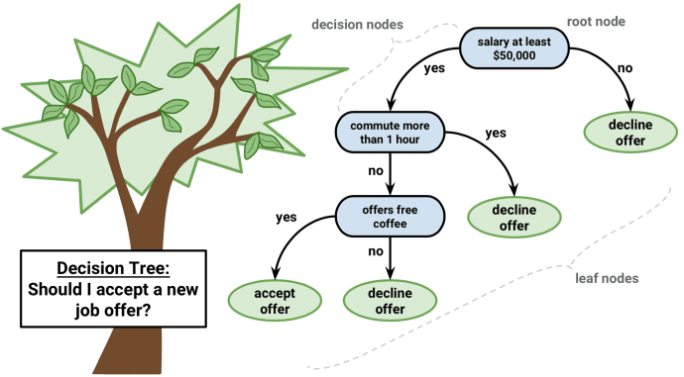
Example

Slide 16
Decision tree algorithm pseudo code
Place the best attribute of the dataset at the root of the tree.
Split the training set into subsets. Subsets should be made in such a way that each subset contains data with the same value for an attribute.
Repeat step 1 a d step 2 on each subset until you find leaf nodes in all the branches of the tree

Slide 17
Advantages of decision tree
Compared to other algorithms decision trees requires less effort for data preparation during pre-processing.
A decision tree does not require normalization of data.
A decision tree does not require scaling of data as well.
Missing values in the data also does NOT affect the process of building decision tree to any considerable extent.
A Decision trees model is very intuitive and easy to explain to technical teams as well as stakeholders.

Slide 18
Decision Tree classifier Result:
we achieved the maximum score of 99.7% when we applied Decision tree classifier to the data.

Slide 19
Random forest classifier
Random forest, like its name implies, consists of a large number of individual decision trees that operate as an ensemble. Each individual tree in the random forest spits out a class prediction and the class with the most votes becomes our model’s prediction
Random forest is like bootstrapping algorithm with Decision tree (CART) model. Say, we have 1000 observation in the complete population with 10 variables. Random forest tries to build multiple CART models with different samples and different initial variables. For instance, it will take a random sample of 100 observation and 5 randomly chosen initial variables to build a CART model. It will repeat the process (say) 10 times and then make a final prediction on each observation. Final prediction is a function of each prediction. This final prediction can simply be the mean of each prediction.

Slide 20
Advantages of random forest
1. Random Forest is based on the bagging algorithm and uses Ensemble Learning technique. It creates as many trees on the subset of the data and combines the output of all the trees. In this way it reduces overfitting problem in decision trees and also reduces the variance and therefore improves the accuracy. 2. Random Forest can be used to solve both classification as well as regression problems. 3. Random Forest works well with both categorical and continuous variables. 4. Random Forest can automatically handle missing values.

Slide 22
Random forest Classifier
we achieved the maximum score of 99.5% when we applied Random Forest classifier to the data.

Slide 23
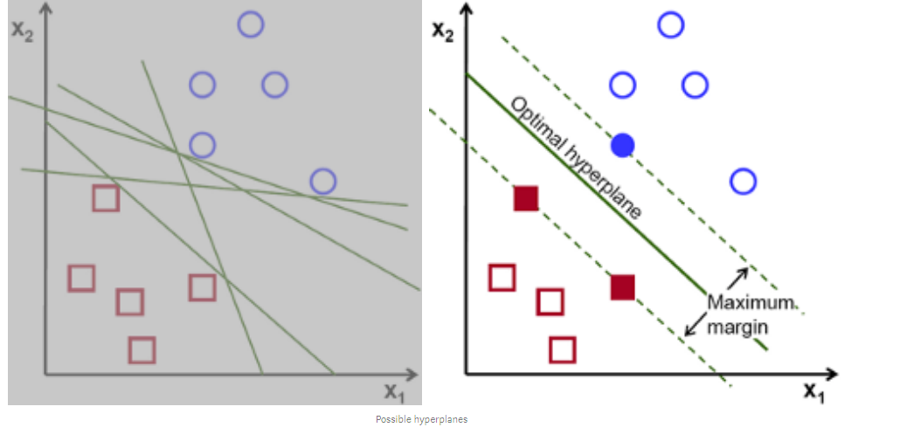
Support Vector machine
Support vector machine is another simple algorithm that every machine learning expert should have in his/her arsenal. Support vector machine is highly preferred by many as it produces significant accuracy with less computation power. Support Vector Machine, abbreviated as SVM can be used for both regression and classification tasks. But, it is widely used in classification objectives.

Slide 24
Algorithm
SVM needs to find the optimal line with the constraint of correctly classifying either class:
Follow the constraint: only look into the separate hyperplanes(e.g. separate lines), hyperplanes that classify classes correctly
Conduct optimization: pick up the one that maximizes the margin

Slide 25
Advantages of Support Vector machine
SVM works relatively well when there is clear margin of separation between classes.
SVM is more effective in high dimensional spaces.
SVM is effective in cases where number of dimensions is greater than the number of samples.
SVM is relatively memory efficient

Slide 26
Result:
we achieved the maximum score of 99.4% when we applied Support Vector Classifier to the data.

Slide 27
Principal Component Analysis
Principal component analysis (PCA) is a technique to bring out strong patterns in a dataset by supressing variations. It is used to clean data sets to make it easy to explore and analyse.
The algorithm of Principal Component Analysis is based on a few mathematical ideas namely:
Variance and Convariance
Eigen Vectors and Eigen values
Principal Component Analysis (PCA) is a statistical procedure that uses an orthogonal transformation which converts a set of correlated variables to a set of uncorrelated variables. PCA is a most widely used tool in exploratory data analysis and in machine learning for predictive models. Moreover, PCA is an unsupervised statistical technique used to examine the interrelations among a set of variables. It is also known as a general factor analysis where regression determines a line of best fit.

Slide 28
Principal Component Analysis Algorithm Steps
1. Find the mean vector.
2. Assemble all the data samples in a mean adjusted matrix.
3. Create the covariance matrix.
4. Compute the Eigen vectors and Eigen values.
5. Compute the basis vectors.
6. Represent each sample as a linear combination of basis vectors.

Slide 29
Advantages of principal component analysis
1. Removes Correlated Features
2. Improves Algorithm Performance
3. Reduces Overfitting
4. Improves Visualization

Slide 30
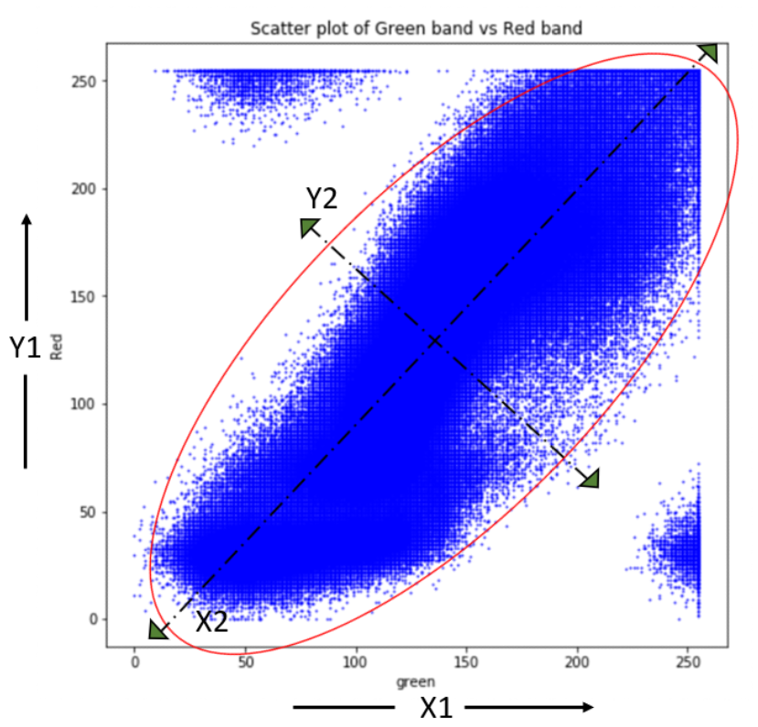
Result
Here we have achieved the score of 98.8%.

Slide 31
Comparison :
 | Decision Tree | Random Forest | KNN | SVM | PCA
Accuracy | 99.7% | 99.5% | 93% | 99.4% | 98.8%
Computation Time | 16.237 | 42.526 | 7.217 | 12.456 | 18.725
advantages | Easy to interpret for small sized trees | Random forest is less compact to interpret | Does requires no training | Working well even if the dataset is not linear seperable | Easy to compute
disadvantages | Large trees can be difficult to interpret | It requires more time to train | Does not work with large dataset | High memory usuage | Depend on previous knowledge
used | classification | Classification & regression | Clustering | Classification | Classification & regression

Slide 32
Final Analysis
The project involved analysis of the heart disease patient dataset with proper data processing. Then, 5 models were trained and tested with maximum scores as follows:
K Neighbors Classifier: 93%
Decision Tree Classifier: 99.7%
Random Forest Classifier: 99.5%
Principal Component analysis: 98.8%
Support vector machine:99.4%

Slide 33
References:
Random Forests for Regression as a Weighted Sum of k-Potential Nearest Neighbours.
Donghua Yu ; Guojun Liu ; Maozu Guo ; Xiaoyan Liu ; Shuang Yao.
2. A Novel Density Peaks Clustering Halo Node Assignment Method Based on K-Nearest Neighbor Theory.
Limin Wang ; Wei Zhou ; Honghuan Wang ; Milan Parmar ; Xuming Han.
3. Usage of Machine Learning for Strategic Decision Making at Higher Educational Institutions.
Yuri Nieto ; Vicente Gacía-Díaz ; Carlos Montenegro ; Claudio Camilo González ; Rubén González Crespo.
4. Efficient and Private Scoring of Decision Trees, Support Vector Machines and Logistic
Regression Models Based on Pre-Computation.
Martine De Cock ; Rafael Dowsley ; Caleb Horst ; Raj Katti ; Anderson C. A. Nascimento ;
Wing-Sea Poon ; Stacey Truex.
5. A missing power data filling method based on improved random forest algorithm.
Wei Deng ; Yixiu Guo ; Jie Liu ; Yong Li ; Dingguo Liu ; Liang Z.

Slide 34
6. Random Forests for Regression as a Weighted Sum of k -Potential Nearest Neighbors
Pablo Fernández-González ; Concha Bielza ; Pedro Larrañaga.
7. A Feature Selection Based Serial SVM Ensemble Classifier
Jianjun Cao ; Guojun Lv ; Chen Chang ; Hongmei Li.
8. Network Security Situation Prediction Based on MR-SVM
Jingjing Hu ; Dongyan Ma ; Chen Liu ; Zhiyu Shi ; Huaizhi Yan ; Changzhen Hu
9. Group-Wise Principal Component Analysis for Exploratory Intrusion Detection
José Camacho ; Roberto Therón ; José M. García-Giménez ;
Gabriel Maciá-Fernández ; Pedro García-Teodoro.
10. Local and Global Randomized Principal Component Analysis for Nonlinear Process Monitoring
Ping Wu ; Lingling Guo ; Siwei Lou ; Jinfeng Gao

Slide 35
THANK YOU

